Slide 1

Capstone Project – Car accident severity
Elida Axundzada – November 11, 2020

Slide 2
Introduction
Road traffic accidents cause every year millions of deaths
Dataset: collected since 2004 to present in Seattle
Purpose: to analyse the dataset to create an application for drivers

Slide 3
Data acquisition & Data cleaning
DATA ACQUISITIONS
194,673 observations with 37 attributes
To predict the possibility of an accident/collision, we used the following attributes:
Collision address type {ADDRTYPE}
Weather {WEATHER}
Light conditions {LIGHTCOND}
Road conditions {ROADCOND}
DATA CLEANING
NaN values AND Unknown data were dropped for better processing

Slide 4
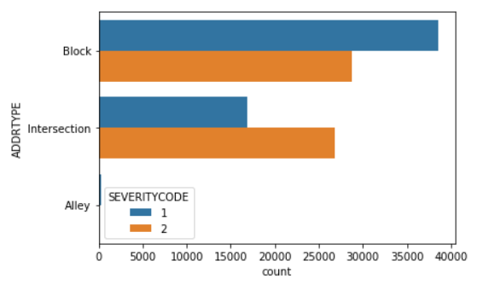
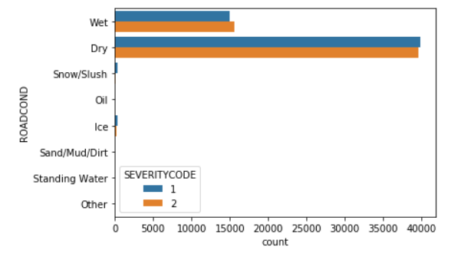
Exploratory analysis
→ Severity Code and Address Type: Severity Code 1 collisions along Blocks are more than on Intersections. The collisions of Severity Code 2 are almost the same on both Blocks and Intersections
→ Severity Code and Road Conditions: most number of collisions happen on dry roads

Slide 5
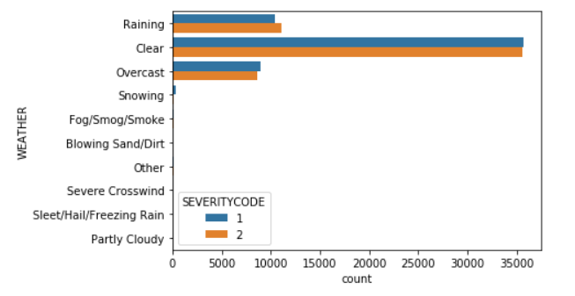
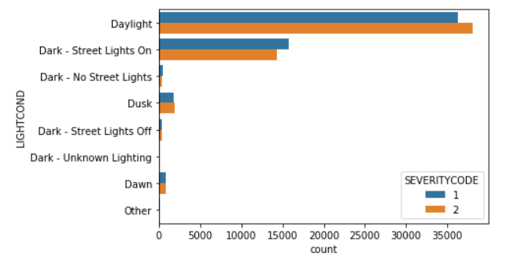
Exploratory analysis (2)
→ Severity Code and Weather: most number of collisions happen on Clear weather
→ Severity Code and Light Conditions: most number of collisions happen on daylight.

Slide 6
Machine learning model
One-hot encoding: independent variables are transformed to the format that can be fit to the machine learning model by using one-hot encoding
Definition of the feature set and the label
Normalization of the data
Data split: dataset is divided into a training set and a test set

Slide 7
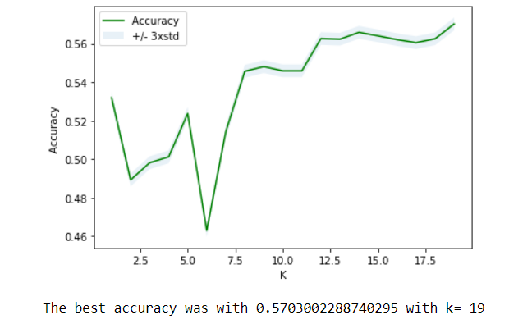

Machine learning model (2)
We have used K-Nearest Neighbor, Decision tree and Logistic Regression for our machine learnings to predict the severity.
K-Nearest Neigboor (KNN)
The best accuracy for the KNN was 0.57 with k=19 using the test data

Slide 8
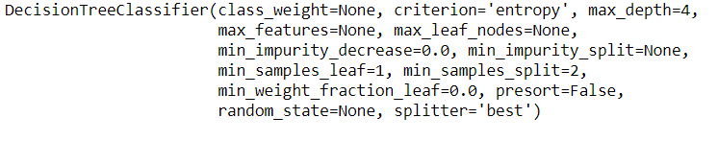
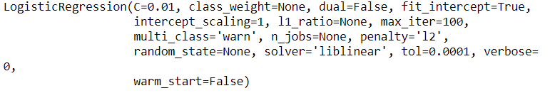
Machine learning model (3)
Decision tree
Logistic Regression

Slide 9
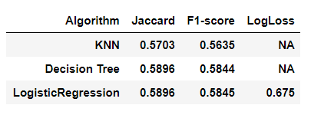
Machine learning model (4)
Results
Accuracy of the Logistic Regression is based on the Logistic Loss (0.675).
The result is not good as we expected because the accuracy of the models is not very high.

Slide 10
Conclusion
Valuable insight on how most of collisions occur on the following conditions:
Clear Weather
Dry Road
Daylight
Address/locations of collisions:
More severity code 1 collisions along Blocks than on Intersections
Collisions of severity code 2 is almost the same on both Block and Intersections

Slide 11
Futures directions
Increase the accuracy of our model by:
Considering other features for analysis
Grouping independent variables into groups
Balancing data

